Slide 1
Group 4 presentation
Activity 2

Slide 2
Members:
Butlay, Nilie
Feliciano, Alfonso
Jovillo, Kent
Julian, Dhon Andrei
Kineta, Liza

Slide 3
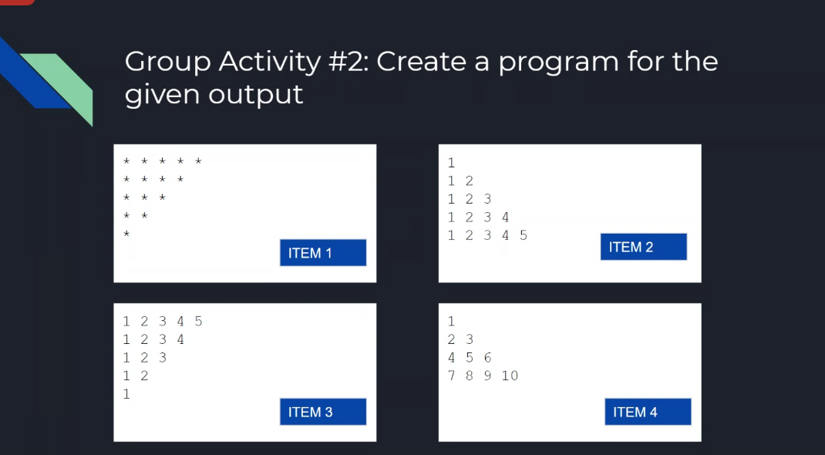
Activity #2: Create a program for the given output

Slide 4
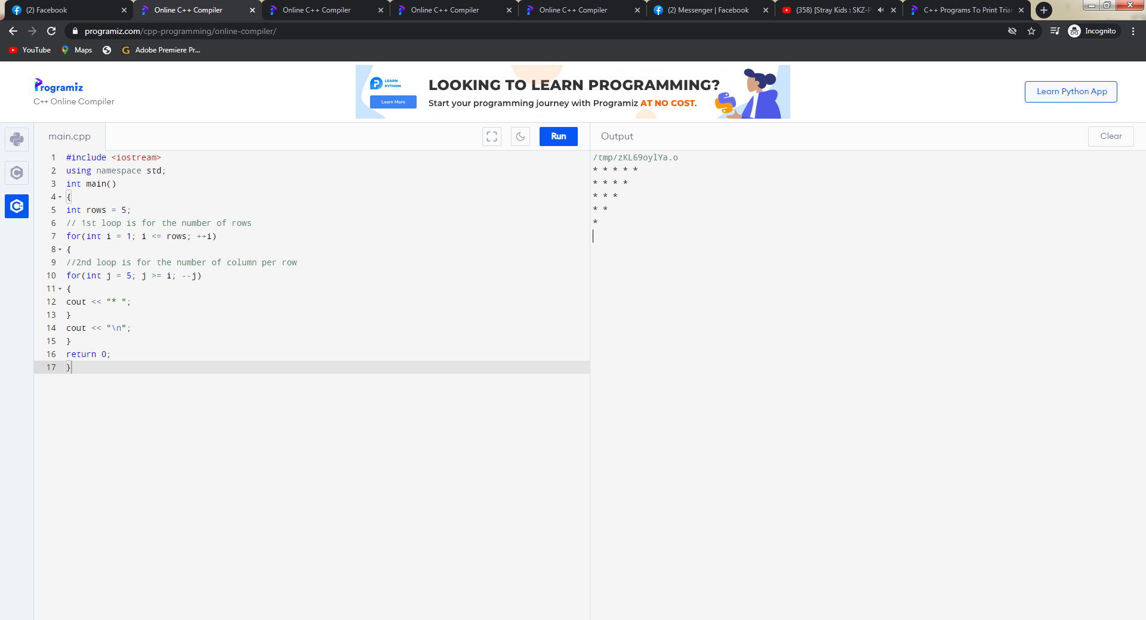
1. Inverted half pyramid using (*)
Input and output:
#include <iostream>
using namespace std;
int main()
{
int rows = 5;
// 1st loop is for the number of rows
for(int i = 1; i <= rows; ++i)
{
//2nd loop is for the number of column per row
for(int j = 5; j >= i; --j)
{
cout << "* ";
}
cout << "\n";
}
return 0;
}

Slide 5
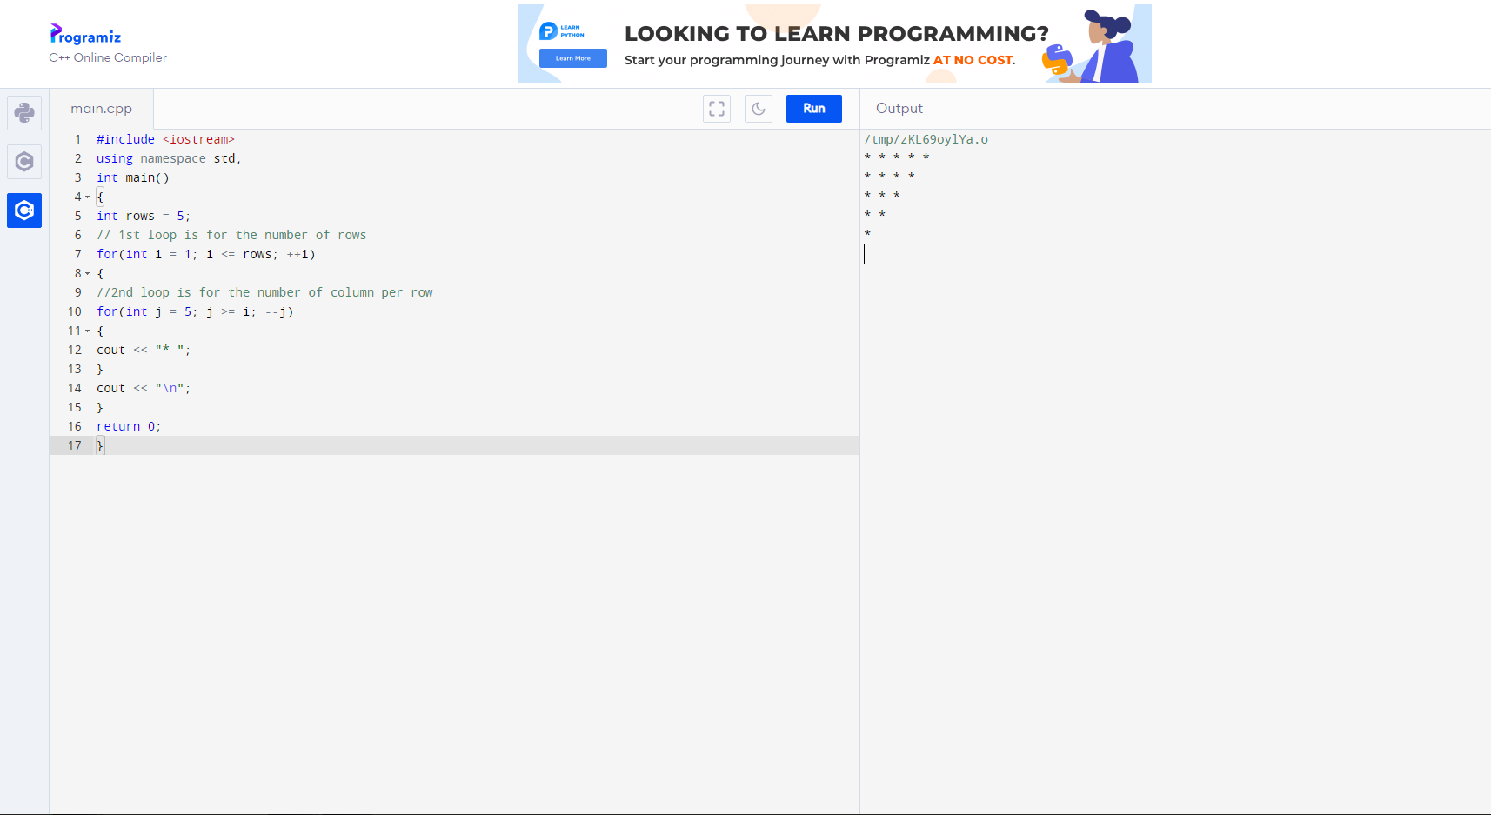

Slide 6
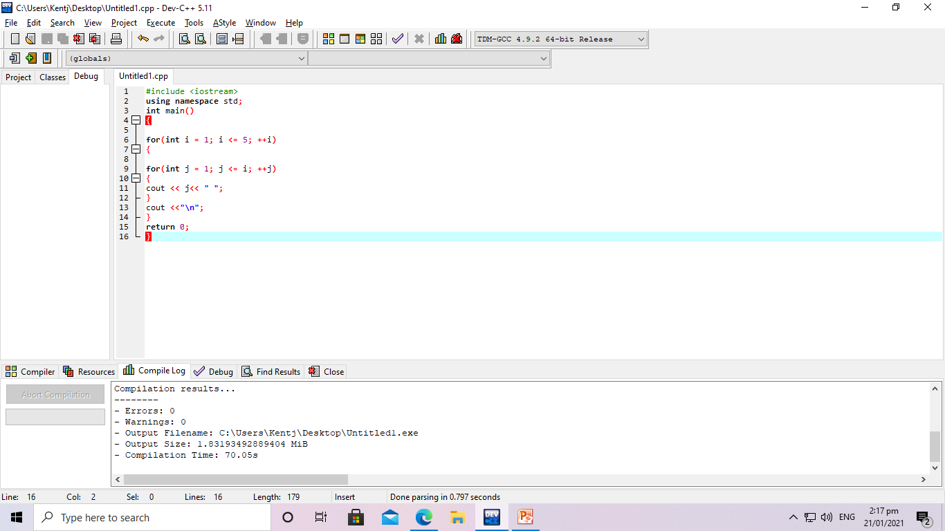
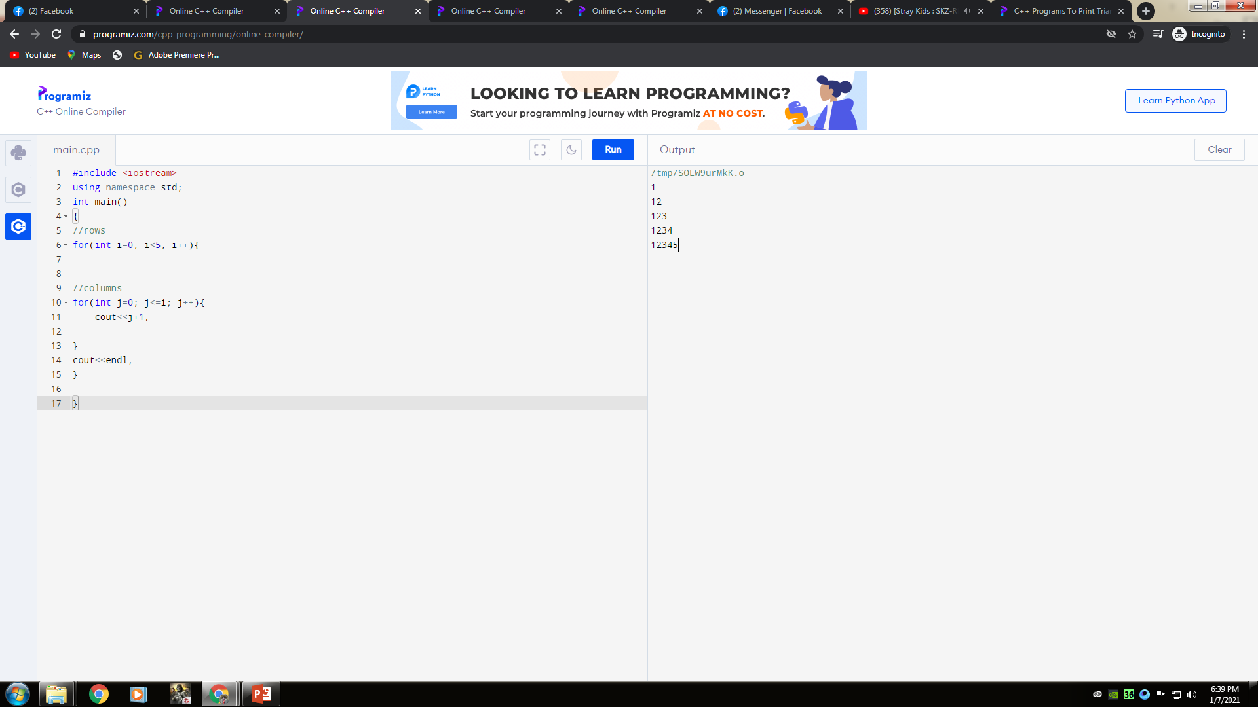
2. Program to print half pyramid using numbers
Input and output:
#include <iostream>
using namespace std;
int main()
{
for(int i = 1; i <= 5; ++i)
{
for(int j = 1; j <= i; ++j)
{
cout << j<< " ";
}
cout <<"\n";
}
return 0;
}

Slide 8
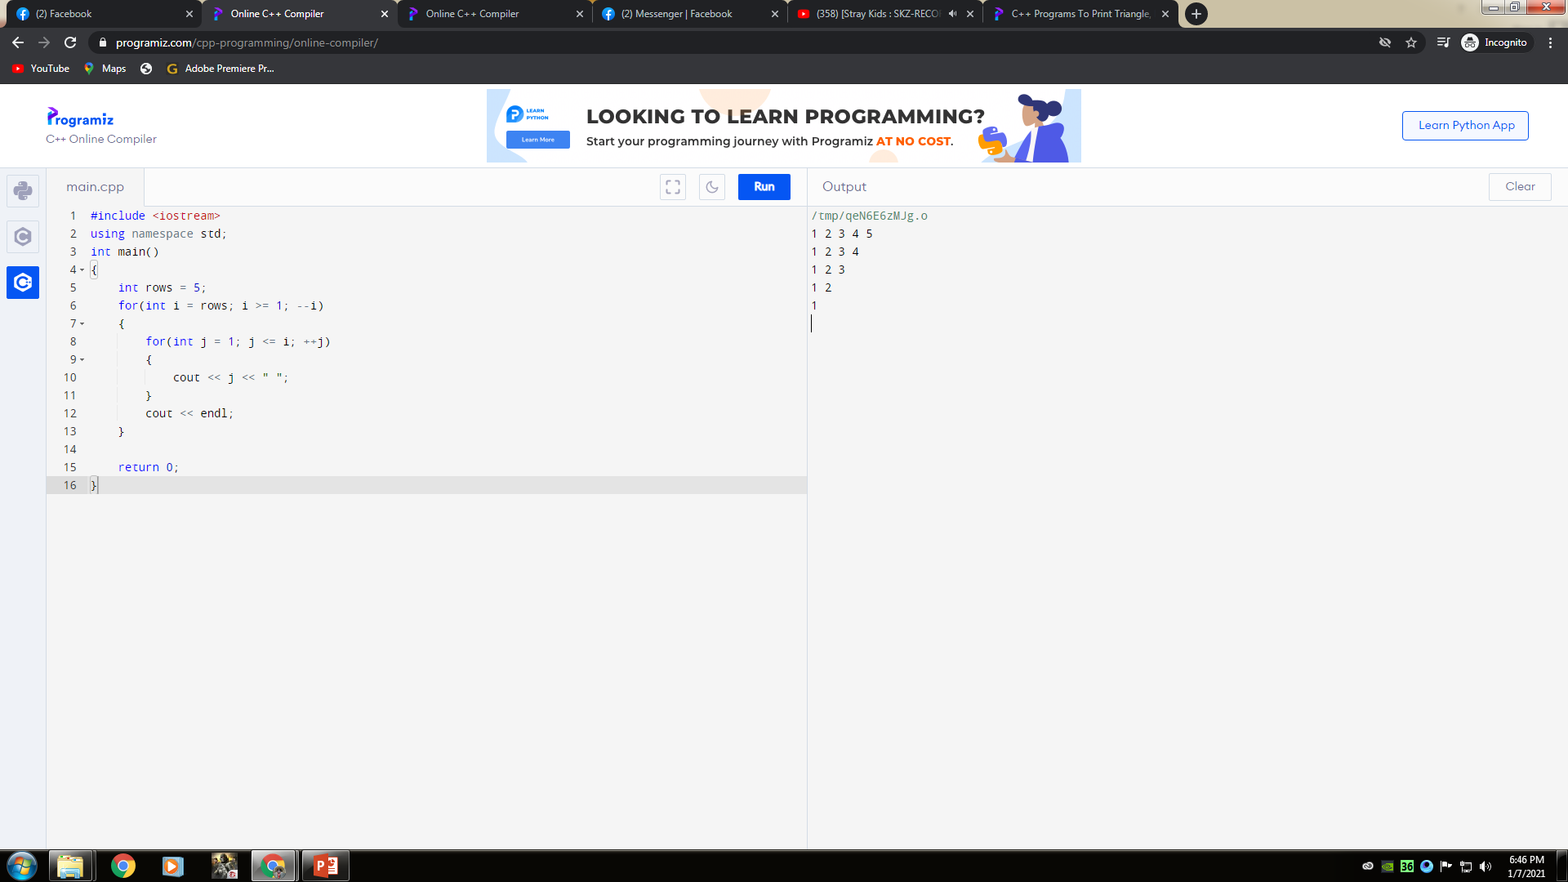
3. Inverted half pyramid using numberts
Input and output:
#include <iostream>
using namespace std;
int main()
{
int rows = 5;
for(int i = rows; i >= 1; --i)
{
for(int j = 1; j <= i; ++j)
{
cout << j << " ";
}
cout << endl;
}
return 0;
}

Slide 10
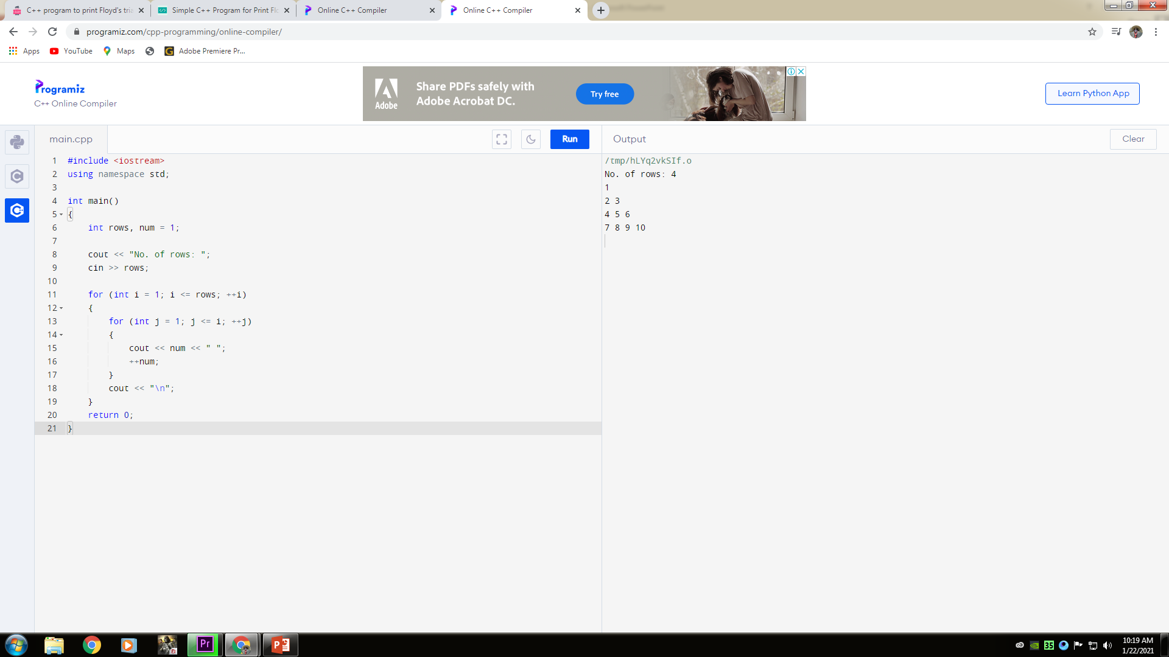
4. Floyd’s Triangle
Input and output:
#include <iostream>
using namespace std;
int main()
{
int rows, num = 1;
cout << "No. of rows: ";
cin >> rows;
for (int i = 1; i <= rows; ++i)
{
for (int j = 1; j <= i; ++j)
{
cout << num << " ";
++num;
}
cout << "\n";
}
return 0;
}

Slide 12
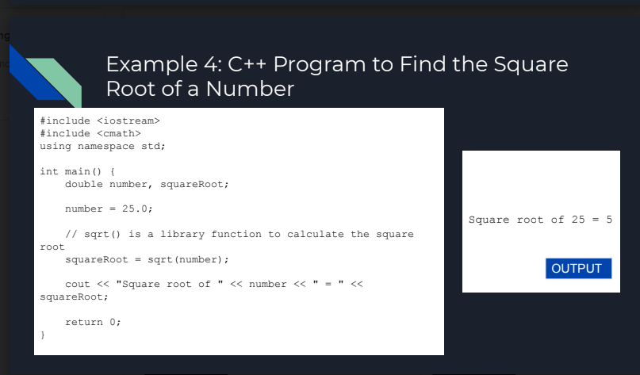
Example 4: c++ Program to find the square root of a number
Activity #2: Use User-defined functions pt. 2

Slide 13
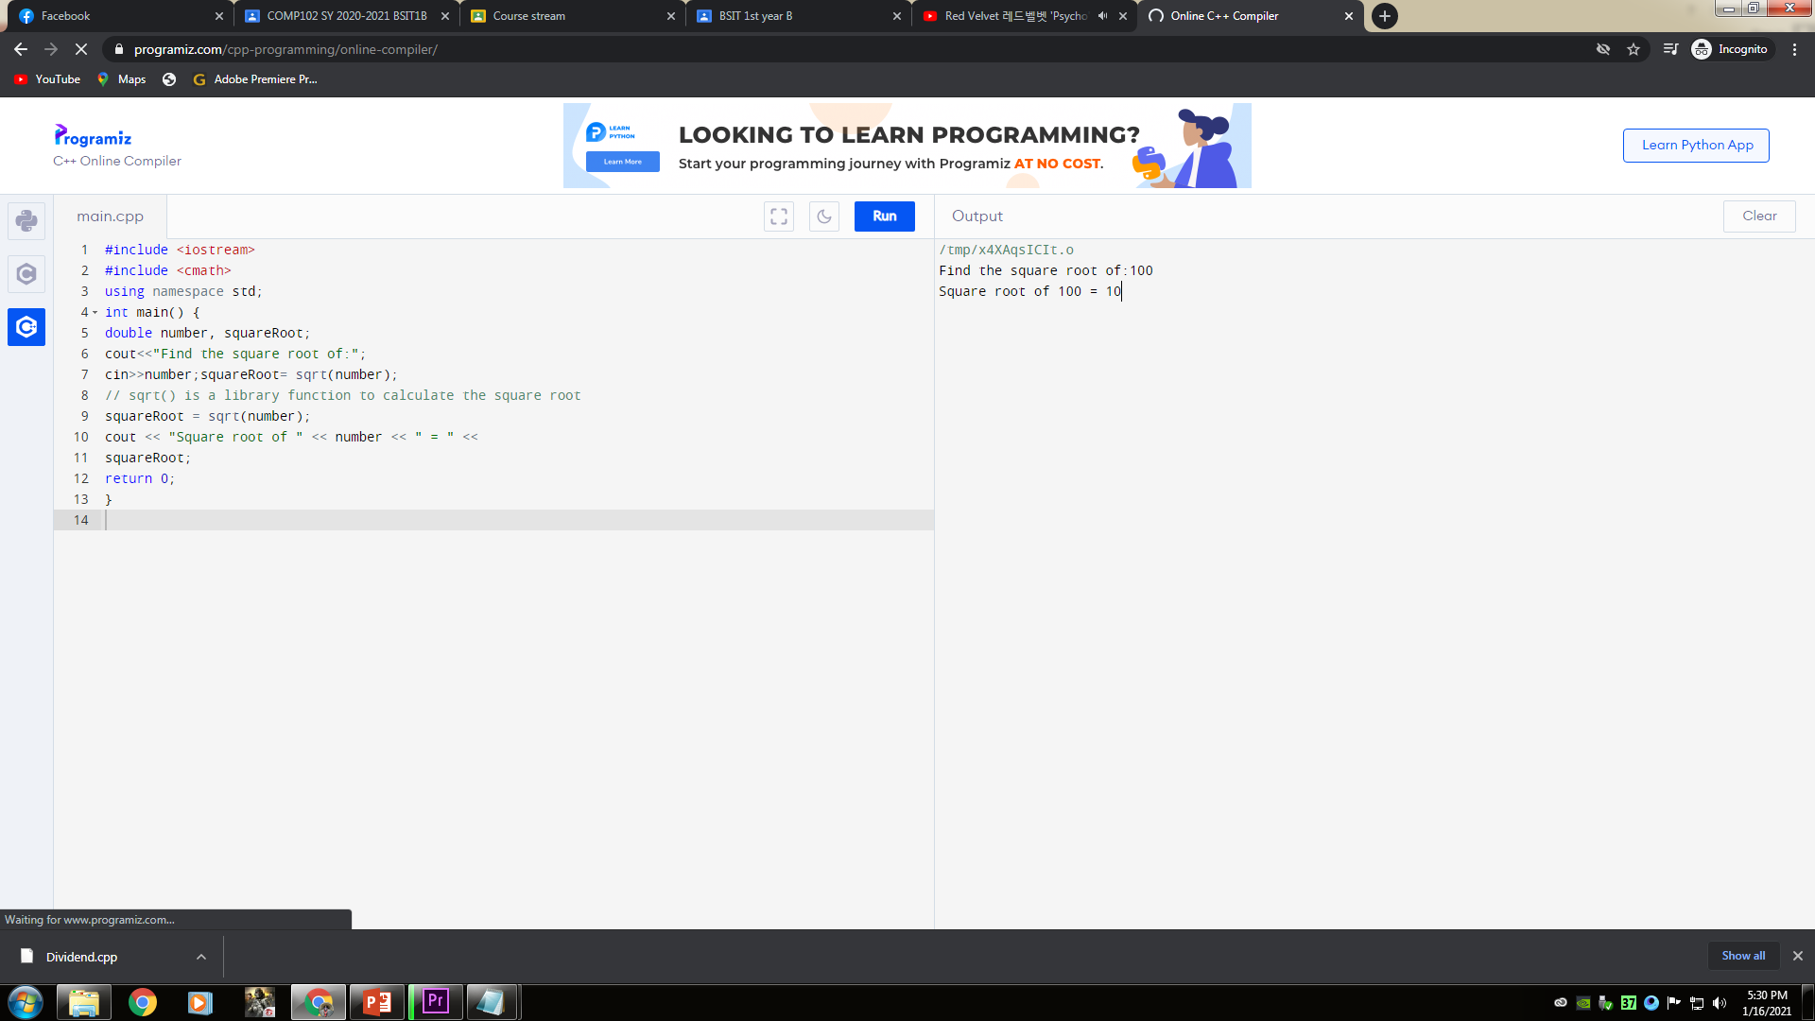
5. Create a program to find the square root of a Input number.
Input and output:
#include <iostream>
#include <cmath>
using namespace std;
int main() {
double number, squareRoot;
cout<<"Find the square root of:";
cin>>number;squareRoot= sqrt(number);
// sqrt() is a library function to calculate the square root
squareRoot = sqrt(number);
cout << "Square root of " << number << " = " <<
squareRoot;
return 0;
}

Slide 15
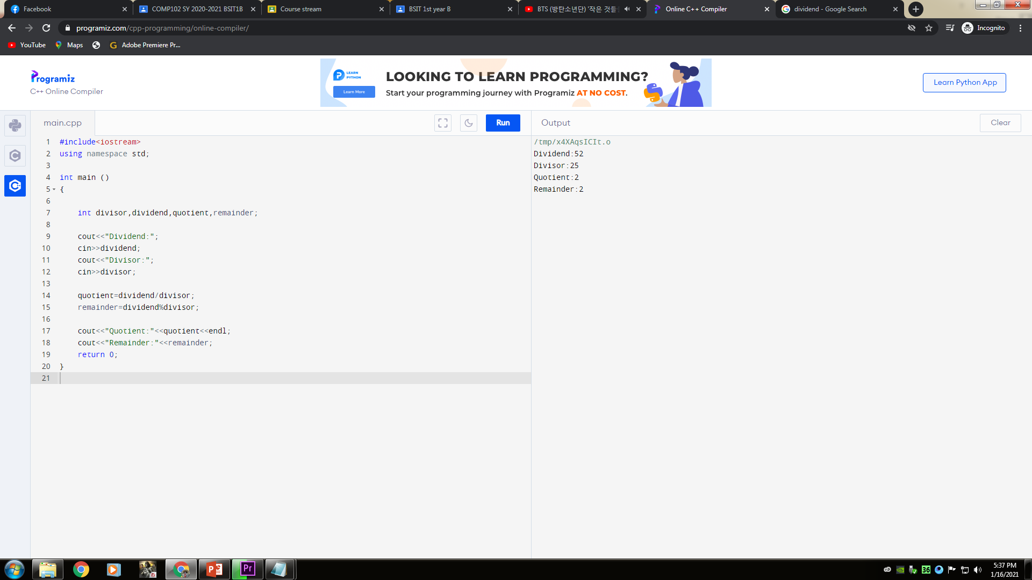
6. Create a program to compute quotient and remainder (Enter dividend and divisor)
Input and output:
#include<iostream>
using namespace std;
int main ()
{
int divisor,dividend,quotient,remainder;
cout<<"Dividend:";
cin>>dividend;
cout<<"Divisor:";
cin>>divisor;
quotient=dividend/divisor;
remainder=dividend%divisor;
cout<<"Quotient:"<<quotient<<endl;
cout<<"Remainder:"<<remainder;
return 0;
}

Slide 17
THANKS FOR LISTENING!
That’s all for today

